Slide 1
Slide 1
Navigating the Middle School Years
FOOTHILL FAMILY
Presented by

Slide 2
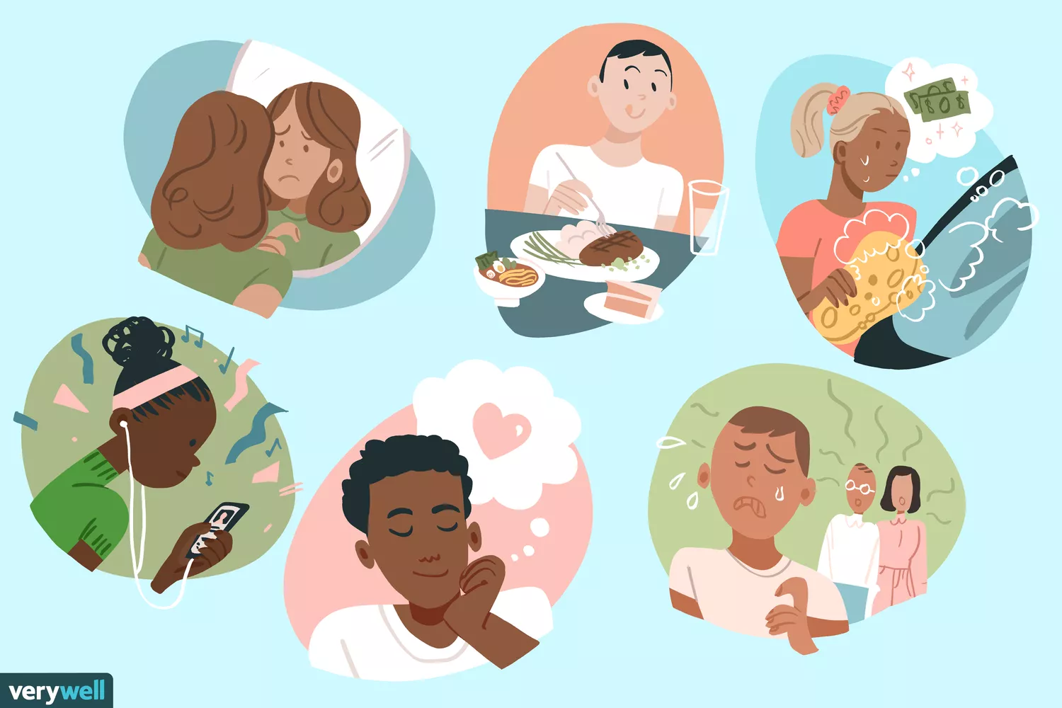
Development
Physical
Growth spurts
Body image
Puberty
Social cognitions
Emotional
Wide range of emotions
Independence: Decision-making skills
Social
Key Relationships: Friends
Exploring identity
FOOTHILL FAMILY
Notes:
During the Middle school years, many changes occur for a child.
Physical: Body’s growth and development
Emotional: Preteens experience a wide range of emotions that come and go frequently. Decisions making skills are shaped as they begin to show some independence.
Social: There is a gradual shift in key relationships from family to friend (peers). We begin to see separation from caregivers and connecting more with their peers. Preteens wanting to connect socially. As they are forming friendships, they are also exploring their identity.
https://www.verywellfamily.com/11-year-old-developmental-milestones-4171925
https://www.verywellfamily.com/12-year-old-developmental-milestones-4171917
Preteens:
Show more concern about body image, looks, and clothes.
Focus on themselves; going back and forth between high expectations and lack of confidence.
Experience more moodiness.
Show more interest in and influence by peer group.
Express less affection toward parents; sometimes might seem rude or short-tempered.
Feel stress from more challenging school work.
Develop eating problems.
Feel a lot of sadness or depression, which can lead to poor grades at school, alcohol or drug use, unsafe sex, and other problems.
Thinking and Learning
Children in this age group might:
Have more ability for complex thought.
Be better able to express feelings through talking.
Develop a stronger sense of right and wrong.

Slide 3
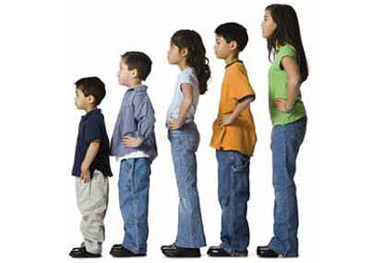
PHYSICAL DEVELOPMENT DURING A PANDEMIC
PUBERTY
Physical growth in children
Taller
Increase in weight
Change in general appearance
Changes in mood
Changes in energy level
How has your child changed during the pandemic?
FOOTHILL FAMILY

Slide 4
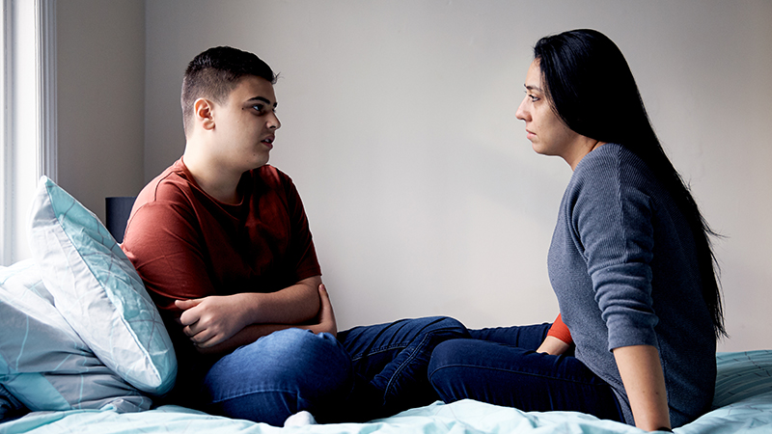
PHYSICAL DEVELOPMENT DURING A PANDEMIC
How to respond to the changes in your child
Validate their mixed feelings about puberty
Normalize any questions they may have about puberty
Watch for possible feelings of insecurity
Emphasize there is no perfect body
Instill positive self-talk
Foster open communication with your child regarding any questions they may have about changes
FOOTHILL FAMILY

Slide 5
EMOTIONAL DEVELOPMENT: Stress Responses
Common Stressors
Tests
Homework
Peer relationships
Bullying
Family conflict
FOOTHILL FAMILY
Notes:
Do you know what may be stressing your children out at the moment? (Menti Poll)

Slide 6
EMOTIONAL DEVELOPMENT: Stress Responses
Irritability and anger
Changes in behavior
Trouble sleeping
Neglecting responsibilities
Eating changes
Getting sick more often
FOOTHILL FAMILY
Notes:
Irritability and anger: Children don’t always have the words to describe how they are feeling and sometimes tension bubbles over into a bad mood. Stressed-out kids and teens might be more short-tempered or argumentative than normal.
Changes in behavior: A young child who used to be a great listener is suddenly acting out. A once-active teen now doesn’t want to leave the house. Sudden changes can be a sign that stress levels are high.
Trouble sleeping: A child or teen might complain of feeling tired all the time, sleep more than usual or have trouble falling asleep at night.
Neglecting responsibilities: If an adolescent suddenly drops the ball on homework, forgets obligations or starts procrastinating more than usual, stress might be a factor.
Eating changes: Eating too much or too little can both be reactions to stress.
Getting sick more often: Stress often shows up as physical symptoms. Children who feel stress often report headaches or stomachaches, and might make frequent trips to the school nurse’s office.

Slide 7
EMOTIONAL NEEDS: Stress Responses
Support your child by:
Doing consistent check ins
Do not be afraid to ask your child about their feelings in regards to current challenges
Listen and Validate
Listening without criticizing
Letting your child know that their words are valid
“I understand you, it sounds like not being able to see your friends makes you sad.”
Helping them identify/express feelings
FOOTHILL FAMILY

Slide 8
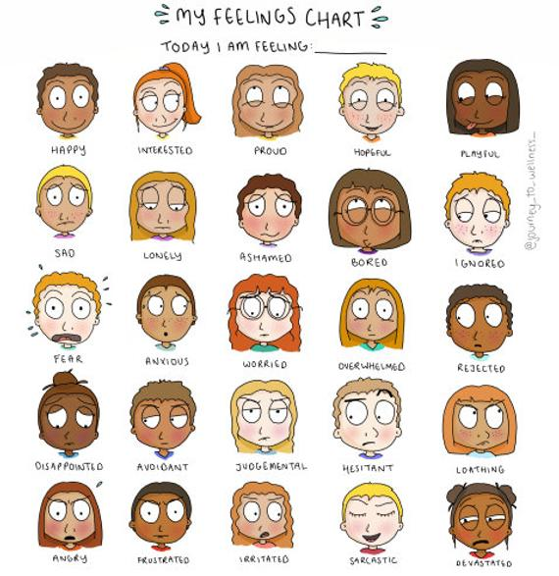
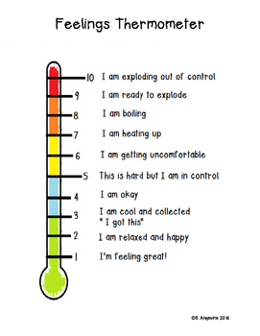
Feeling Identification Tools
FOOTHILL FAMILY
Notes:
Some children may have a hard time expressing themselves so giving them feeling identification tools to help them label their feelings and rate their feelings can be a great tool for them

Slide 9
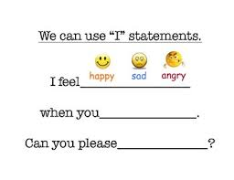
EMOTIONAL NEEDS: Stress Responses
Support your child by:
Encouraging them to express themselves in healthy ways (i.e., using I statements)
This can be helpful when engaging in conflict resolution strategies
FOOTHILL FAMILY
Notes:
You can teach them to acknowledge their feelings and using their thinking brain to come up with what they need to ask of you as a caregiver to help them.

Slide 10
EMOTIONAL NEEDS: Stress Responses
Support your child by:
Modeling healthy coping as caregivers
Encouraging independent problem solving skills
Promoting media literacy
Helping them combat negative thinking
Making sure they get enough sleep and eat well – can be managed by setting up ROUTINES/SCHEDULES
FOOTHILL FAMILY
Notes:
Model healthy coping. Caregivers can talk with children about how they’ve thought about and dealt with their own stressful situations.
problem-solvers. It’s natural to want to fix your child’s problems. But when parents swoop in to solve every little glitch, their children don’t have a chance to learn healthy coping skills. Let your children try to solve their low-stakes problems on their own, and they’ll gain confidence that they can deal with stressors and setbacks.
Promote media literacy. Today’s kids spend a lot of time online, where they can run into questionable content, cyberbullying or the peer pressures of social media. Parents can help by teaching their children to be savvy digital consumers, and by limiting screen time.

Slide 11
EMOTIONAL NEEDS: Stress Responses
Support your child by:
Catching your child being good!
Praising them! Praise should be immediate, specific and sincere
Labeling what you see, describe what you feel, and sum up the child’s praiseworthy behavior in a word:
ex: “I see a really clean floor. I appreciate your help with cleaning because it made my day easier. You are great helper!”
FOOTHILL FAMILY
Notes:
Model healthy coping. Caregivers can talk with children about how they’ve thought about and dealt with their own stressful situations.
problem-solvers. It’s natural to want to fix your child’s problems. But when parents swoop in to solve every little glitch, their children don’t have a chance to learn healthy coping skills. Let your children try to solve their low-stakes problems on their own, and they’ll gain confidence that they can deal with stressors and setbacks.
Promote media literacy. Today’s kids spend a lot of time online, where they can run into questionable content, cyberbullying or the peer pressures of social media. Parents can help by teaching their children to be savvy digital consumers, and by limiting screen time.

Slide 12
Being and Doing Messages
FOOTHILL FAMILY
Notes:
Praise can be divided into being and doing messages….to discuss this, let’s think of a ladder. If we want to reach towards a goal, similar to climbing a ladder, we need to have both sides of a ladder to secure our steps. Being and Doing Messages are ways in which caregivers can nurture emotional development.

Slide 13
Being Messages
It’s a way to communicate unconditional love
“I love you”
“I’m glad you are my kid”
“Welcome home”
“When you feel sad, you can always talk to me about what’s bother you”
A hug, kiss, pat on the back
FOOTHILL FAMILY
Notes:
It is valuing our children for who they are and embracing all of the things that make them unique, even some of the traits that make them challenging to raise. It is one of the ways we let them know we cherish them. People need to hear ‘Being Messages’ throughout their lives.

Slide 14
Doing Messages
Catch your child doing something good
“Look how hard you worked on this assignment!”
“With practice, you can do it.”
“Thank you for your help. It made things easier for me.”
“You have a talent in coloring!”
“It was thoughtful of you to help out your friend.”
High fives, thumbs up, a nod of approval when the child accomplishes something
FOOTHILL FAMILY
Notes:
Doing messages change as children mature and as they work on different areas of development.
Note Card exercise: have parents read out a complement to another parent and reflect on how it felt– on note card: “The fact that you are here today is a big deal. You really care about kid(s) and this makes you a great and caring parent”. “Your presence at this meeting really shows me how much you love and care for your child. You’re a great parent.” How did this exercise make you feel?

Slide 15
It’s all about balance
Balancing both types of messages is crucial. Overdoing one message and not balancing it with the other can result in a child who does not feel worthy or lovable if the child is not achieving, feels the need to be a perfectionist, and who feels empty and insatiable inside, as if the child can never get enough love.
FOOTHILL FAMILY

Slide 16
SOCIAL DEVELOPMENT
Friendships:
Social relationships are a big component to their development. Fostering ways to connect with others would be beneficial virtually
Conflict Resolution:
Sheltering at home may increase conflicts so it’s important to resolve them
Monitoring Online Activity & Social Media:
There may be an increase in online use more than usual during this time. Monitoring and implementing appropriate content and use would be helpful.
FOOTHILL FAMILY
Notes:
What to expect with children during COVID
Social needs: As friendships are a big component to the social needs of preteens, fostering ways to connect with others would be beneficial. Teens may feel sad and upset that they cannot see their friends.
Conflict Resolution: Sheltering at home may increase conflicts at home. It would be important to resolve them.
Internet: Expect that there may be an increase in preteens being online more than usual during this time. Monitoring and implementing appropriate content and use would be helpful.
https://qz.com/1823522/how-to-help-pre-teen-kids-in-a-coronavirus-lockdown/

Slide 17
How can I monitor my child's online activity?
5 tips to monitor child's online activities:
Use the apps that they are using. The best way to understand what your child is doing online is to be on the same app with them.
Google search the app to find out what it is about.
Talk regularly to your child about online safety.
Set internet rules and regulations.
Monitoring by age & Parental control - call your internet company and ask about parental controls and how to use them.
FOOTHILL FAMILY

Slide 18
Conflict Resolution Strategy
Identify the problem or root of conflict
Identify possible options for resolution
Weigh the cost and benefits of each resolution before choosing
Implement resolution
If chosen resolution did not resolve the conflict review the other options previously listed and choose another.
When going through this process set guidelines to not allow accusations or name calling and model appropriate volume to avoid escalating the conflict
FOOTHILL FAMILY
Notes:
These children have developed a more advanced reasoning and problem solving skills and with that skill, it is typical for them to talk back, challenge, sulk and look for loopholes in rules. This may result in family conflicts. However, being able to manage conflict constructively can instead create opportunities to reach many mutually beneficial decisions. The conflict resolution process can bring your family closer together, allow you to learn from each other, and get to know, understand, love, and respect each other even better. As long as there are differences of opinion, there will always be conflict. But knowing how to manage it productively and turn it into a win-win situation is the key to a healthy relationship, friendship, and family.
***Refer to Handout on the 5 STEPS

Slide 19
Modeling Healthy Behaviors
Use problem-solving skills to deal with challenges or conflicts in a calm and productive way. Getting upset or angry when a problem comes up teaches your child to respond in the same way.
Show kindness and respect to others in your words and your actions.
FOOTHILL FAMILY
Notes:
Modeling Healthy behaviors means that we are making a direct and purposeful decisions to manage difficult situations. Our Thinking Brain (upstairs brain) is activated when we are choosing to make healthy behavioral choices. We become good problem solvers when we address challenges in calm and productive ways.

Slide 20
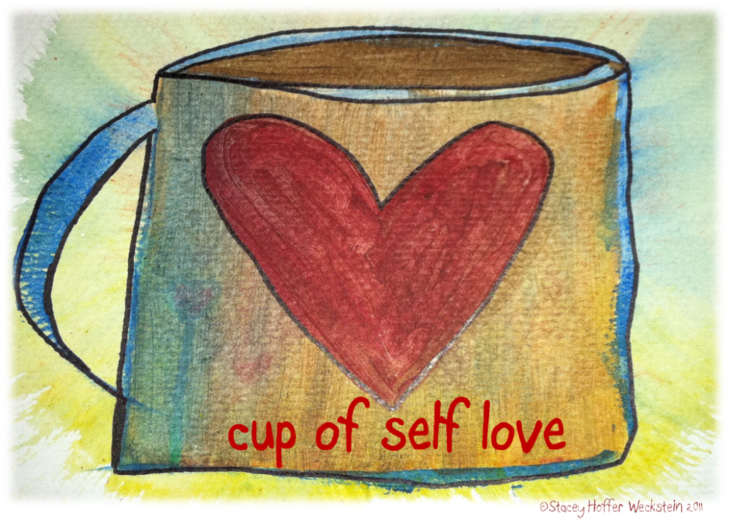
Self-Compassion
Be supportive and understanding towards yourselves when you’re having a hard time, rather than being harshly self-critical
Remember that everyone makes mistakes and experiences difficulties at times. You are not alone!
FOOTHILL FAMILY
Notes:
Self-compassion is such an important practice that is great to model for our families. But is so hard to do for so many people. It’s easier to be hard on ourselves rather than compassionate and being self-compassionate requires deliberate practice.
Let of being a perfect parent bc there is no such thing.

Slide 21
WHERE CAN YOU GET HELP AND INFORMATION?
Foothill Family Service Intake/Departamento De Admision 626 993-3000
211 LA County Information - DIAL 211
Linea Informativa Condado De Los Angeles –
Marque 211
Para Español http://v5.healthycity.org/es
FOOTHILL FAMILY
Notes:
Where Can You Get Help And Information?
Mental Health Clinics - there are several in this community
Foothill Family –what we offer
Foothill Family’s MediCal Contract –school based treatment
Foothill Family—provides some fee for service treatment for families who do not have Medi-Cal
Private Insurance
211- for more information on all kinds of community services

Slide 22
Thank you!
FOOTHILL FAMILY

